Slide 1
Big Question
What does it mean to be a Jew?

Slide 2
LQ: What is God’s promise to Abraham?

Slide 3
What do we already know about the Jewish faith?
What is Judaism - watch
LQ: What is God’s promise to Abraham?

Slide 4
What is a promise and when has a promise been made to you?
Can you write it down or talk about a promise with someone
LQ: What is God’s promise to Abraham?

Slide 5
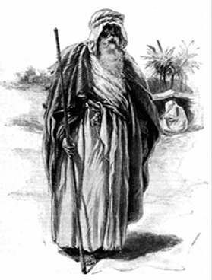
Who was Abraham?
Jews regard Abraham as the first Patriarch of the Jewish people. Abraham was the first person to teach the idea that there was only one God; before then, people believed in many gods.
LQ: What is God’s promise to Abraham?

Slide 6
What was he promised?
The Lord had said to Abram, “Go from your country, your people and your father’s household to the land I will show you.
I will make you into a great nation, and I will bless you; I will make your name great, and you will be a blessing. I will bless those who bless you, and whoever curses you I will curse; and all peoples on earth will be blessed through you.”
Genesis 12: 1-3
What does it mean?
LQ: What is God’s promise to Abraham?

Slide 7
If you have a Bible at home look up
Genesis 22: 1-13
Please note that this verse is on the next slide…
LQ: What is God’s promise to Abraham?

Slide 8
22 Some time later God tested Abraham. He said to him, “Abraham!”
“Here I am,” he replied.
² Then God said, “Take your son, your only son, whom you love—Isaac—and go to the region of Moriah. Sacrifice him there as a burnt offering on a mountain I will show you.”
³ Early the next morning Abraham got up and loaded his donkey. He took with him two of his servants and his son Isaac. When he had cut enough wood for the burnt offering, he set out for the place God had told him about. ⁴ On the third day Abraham looked up and saw the place in the distance. ⁵ He said to his servants, “Stay here with the donkey while I and the boy go over there. We will worship and then we will come back to you.”
⁶ Abraham took the wood for the burnt offering and placed it on his son Isaac, and he himself carried the fire and the knife. As the two of them went on together, ⁷ Isaac spoke up and said to his father Abraham, “Father?”
“Yes, my son?” Abraham replied.
LQ: What is God’s promise to Abraham?

Slide 9
“The fire and wood are here,” Isaac said, “but where is the lamb for the burnt offering?”
⁸ Abraham answered, “God himself will provide the lamb for the burnt offering, my son.” And the two of them went on together.
⁹ When they reached the place God had told him about, Abraham built an altar there and arranged the wood on it. He bound his son Isaac and laid him on the altar, on top of the wood. ¹⁰ Then he reached out his hand and took the knife to slay his son. ¹¹ But the angel of the Lord called out to him from heaven, “Abraham! Abraham!”
“Here I am,” he replied.
¹² “Do not lay a hand on the boy,” he said. “Do not do anything to him. Now I know that you fear God, because you have not withheld from me your son, your only son.”
¹³ Abraham looked up and there in a thicket he saw a ram^{[a]} caught by its horns. He went over and took the ram and sacrificed it as a burnt offering instead of his son.
LQ: What is God’s promise to Abraham?

Slide 10
Now think about how it feels when someone breaks a promise.
Has this happened to you?
LQ: What is God’s promise to Abraham?

Slide 11
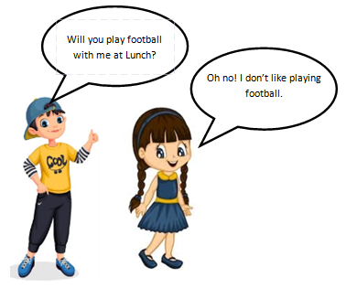
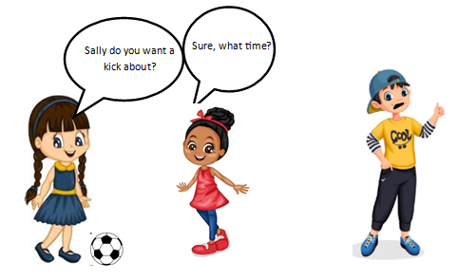
What is happening in this situation?
What was the promise?
Why was it broken?
How do each of them feel?
Can you explain what is happening and how they each may feel?
LQ: What is God’s promise to Abraham?

Slide 12
If you have a bible look up
Genesis 22: 17-18
Read the verse out loud – what does it mean?
Please see following slide for verse.

Slide 13
¹⁷ I will surely bless you and make your descendants as numerous as the stars in the sky and as the sand on the seashore. Your descendants will take possession of the cities of their enemies, ¹⁸ and through your offspring all nations on earth will be blessed, because you have obeyed me.”
LQ: What is God’s promise to Abraham?

Slide 14
Can you write a response to these questions:
What is a promise?
2. Do you think God’s promise to Abraham came true?
3. Explain why a promise might be really important to you.
© Why do you think God tested Abraham and how does this story relate to trust and faith?
LQ: What is God’s promise to Abraham?

